Slide 1

Notes:
24,25,26

Slide 2
Oracle Database Backup-and-Recovery
Best Practices and New Features
To Quoc Cuong
Nguyen Thanh Tung
Notes:
Oracle delivers a complete backup-and-recovery solution comprising Oracle Recovery Manager (RMAN), Oracle Secure Backup, Oracle Data Recovery Advisor, and Oracle Flashback-leveraging disk, tape, and innovative cloud technologies. This session outlines how these features can be used as essential components of a high-availability strategy for superior protection from a wide range of logical and media corruptions. The session also covers the new Oracle Database 11g Release 2 backup-and-recovery capabilities. Hear directly from a major Oracle customer about its backup-and-recovery design and experiences with multiterabyte Oracle Real Application Clusters (Oracle RAC) 11g online transaction processing (OLTP) and archival/reporting databases.

Slide 3


Agenda
<Insert Picture Here>
Data Protection Concerns
Oracle Data Protection Planning & Solutions
Oracle Backup & Recovery Solutions
  Physical Data Protection
    Recovery Manager
    Oracle Secure Backup
  Logical Data Protection
    Flashback Technologies
  Recovery Analysis
    Data Recovery Advisor
Demo
Q&A

Slide 4

Data Protection Concerns
Meeting recovery SLAs?
Reducing exposure to data loss?
Dealing with long-term backup storage?
Management complexity?
Budget?
…Where do I begin?
Notes:
If you have a critical dependency on a supplier (service or product) it is important that you have an agreement to define the obligations of both parties. This certainly applies to external suppliers, but in large organizations, it may apply to internal ones as well. The Service Level Agreement, or SLA, defines the parameters of the service. Critically, in the context of this portal, it also defines the levels of availability and response in emergency situations.
The SLA therefore is a very important document indeed.

Slide 5

Assess Recovery Requirements
First Step in Data Protection Planning
Identify critical data from rest
Design recovery requirements around data criticality
  Assess tolerance for data loss - Recovery Point Objective (RPO)
    How frequently should backups be taken?
    Point-in-time recovery required?
  Assess tolerance for downtime - Recovery Time Objective (RTO)
    Downtime: Problem identification + recovery planning + systems recovery
    Tiered RTO per level of granularity, e.g. database, tablespace, table, row
  Determine backup policy
    Onsite, offsite,
Assess data protection requirements
  Physical: Disasters, outages, failures, corruptions
  Logical: Human errors, application errors
Notes:
First step is to start with how critical lost or unavailable data is to your business – how much will the company lose in $x/hr of downtime, not to mention in productivity and labor costs, if a database is down? This cost is important as it will justify HW and storage expenditures to prevent and recover from those outages.
Once the business cost and impact is determined for unavailable data, next step is to classify those databases and potentially data sets (recall database consolidation trend), according to criticality. E.g. you may have large DW (dataware house) reporting system that can tolerate 12 hours worth of lost data, as batch loads can be re-run, with several hours of acceptable downtime. This system may fit well with a disk/tape backup strategy. You may also have a critical OLTP system that can tolerate no more than a few mins worth of lost data and several mins of acceptable downtime, e.g. online sales processing, which can cost the company $100K/hr in lost revenue, if unavailable. In this case, traditional backups will not suffice and minimal downtime solution, e.g. Data Guard, should be evaluated.
First key requirement is RPO – how much data loss is acceptable? Are there some databases and data sets that require more frequent backups than others? If I need PITR (Point In Time Recovery), have I provisioned sufficient disk space for archived logs?
Second key requirement is RTO – how much recovery time can I tolerate? Can I tolerate hours, or only minutes?
* Recovery Object Granularity (ROG). ROG measures the level of objects that a solution is capable of recovering. We are the best there because we can recover just table or row.
The other important characteristics for DW databases is Recovery Event Granularity (REG). REG measures the capability of a recovery management solution to track events and to recover a failed application or missing data to a specific event. E.g., if event is an ETL load, you should be able to easily revert back if ETL load is bad.
What are your Recovery Time Objectives (RTO) – i.e. how quickly must you recover from a data failure?
RTO may vary by database and/or server
Consider combined disk and tape backup strategy for critical databases to meet more pressing RTO requirements
Determine desired recovery capability from disk and tape
What time period represents most frequent recovery needs?
Do you need to retain data on a long-term basis?
Review Oracle Suggested Strategy
Utilize the benefits of integrated disk and tape backup using technologies such as Fast Recovery Area, RMAN and Oracle Secure Backup

Slide 6













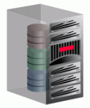

Oracle Maximum Availability Architecture
Robust & Integrated Data Protection
Active Data Guard
Fully Active
Failover Replica
Production Site
Standby Site
Database
Database
Data Recovery Advisor
Intelligent, Guided
Recovery Analysis
Storage
Storage
Recovery Manager (RMAN) &
Oracle Secure Backup (OSB)
Low Cost, High Performance Backup & Recovery
Flashback Technologies
Correct Errors by
Moving Back in Time

Slide 7
Oracle Data Protection Solutions
Backup & Recovery | Recovery Time Objective (RTO)
Physical Data Protection Recovery Manager (RMAN) Oracle Secure Backup (OSB) | Hours/Days
Logical Data Protection Flashback Technologies | Minutes/Hours
Recovery Analysis Data Recovery Advisor | Minimizes time for problem identification & recovery planning
Disaster Recovery | Recovery Time Objective (RTO)
Physical Data Protection Active Data Guard | Seconds/Minutes

Slide 8


Oracle Backup & Recovery Solutions
“Backup and Recovery on Steroids”
Physical Data Protection
Recovery Analysis
Data Recovery Advisor
File System Data
Oracle Databases
UNIX
Linux
Windows
NAS
Logical Data
Protection
Flashback Technologies
Recovery Manager (RMAN)

Slide 9
Agenda
<Insert Picture Here>
Data protection concerns
Oracle Data Protection Planning & Solutions
Oracle Backup & Recovery Solutions
  Physical Data Protection
    Recovery Manager
    Oracle Secure Backup
  Logical Data Protection
    Flashback Technologies
  Recovery Analysis
    Data Recovery Advisor
Demo
Q&A

Slide 10




Backup & Recovery Foundation
Complete Oracle Solution from Disk to Tape
Oracle Secure Backup (OSB)
File System Data
Tape Backup
UNIX
Linux
Windows
NAS
Oracle Recovery Manager (RMAN)
Oracle Databases
Fast Recovery Area
Oracle Secure Backup (OSB) Cloud Module
Amazon S3
Cloud Storage
Oracle backup and recovery for your entire IT environment
Multiple media options available to meet the most stringent SLAs
  Local disk, remote Cloud storage, physical tape
Notes:
Oracle Secure Backup is centralized tape backup management software protecting the Oracle database and file systems in distributed UNIX, Linux, Windows and Network Attached Storage (NAS) environments.
From one central console, you can easy manage the distributed servers and tape devices within the backup domain.
As Oracle is no longer just a database company, Oracle Secure Backup provides tape backup for application files as well as the database. Integrated with Recovery Manager (RMAN), Oracle Secure Backup provides the media management layer for RMAN backups to tape.
While tightly integrated with the Oracle database, Oracle Secure Backup is a standalone product offering with an independent release schedule and versioning from the database. OSB 10.1 was released in April 2006 and OSB 10.2 was released in Nov 2007.
3rd Party Media Management Software can be EXPENSIVE, and cost thousands per database server for RMAN integration! OSB will save customer money….Oracle ROI
Oracle - Single vendor solution with RMAN+OSB reduces complexity for customer…eliminates finger pointing in multi-vendor solution

Slide 11




Oracle Recovery Manager (RMAN)
Oracle-integrated Backup & Recovery Engine
Oracle Enterprise
Manager
Features:
  Block validation
  Online block-level recovery
  Tablespace/data file recovery
  Online, multi-streamed backup
  Fast Backup Compression
  Backup encryption
Oracle Secure
Backup
RMAN
Tape Drive
Integrated disk, tape & cloud backup leveraging the Fast Recovery Area and Oracle Secure Backup
Fast Recovery
Area
Database
Cloud
Notes:
Recovery Manager (RMAN) - A component that establishes a connection with a server process and automates the movement of data for backup and recovery operations.
Recovery Manager (RMAN) – ensures valid backup & restore
Always verifies block checksums on backup & restore
Provides optional logical block validation (e.g. missing row piece)
Checks on-demand for backup / restore corruptions without creating backups / restores (BACKUP VALIDATE / RESTORE VALIDATE)
Provides online recovery of individual block corruptions or all identified corruptions with Block Media Recovery (RECOVER BLOCK)
Multi-stream backup: RMAN can back up or restore a single file in parallel by dividing the work among multiple channels. Each channel backs up one file section, which is a contiguous range of blocks. This speeds up overall backup and restore performance, and particularly for bigfile tablespaces, in which a data file can be sized upwards of several hundred GB to TB's.
backup compression algorithm (BZIP2),

Slide 12

Oracle Fast Recovery Area
Automatic Disk-to-Disk (D2D) Backup & Recovery
Fast Recovery Area – Integrated D2D backup and recovery
  Favorable disk economics – low-cost disks used for recovery area
  Oracle makes it even better with instantaneous restore:
    switch datafile 4 to copy;
    recover datafile 4;
Fast incremental backups
  Backs up only changed blocks
  Changed blocks are tracked using a very efficient algorithm, e.g. 20x faster
Nightly incremental backup rolls forward recovery area backup
  No need to do full backups
    recover copy of database with tag ‘ORCL’;
Database
Area
Nightly
Apply
Validated
Incremental
Fast Recovery
Area
Weekly
Archive
To Tape
Integrated backup-storage tiering
Notes:
RMAN, which is Oracle’s Backup & Recovery solution, fully automates disk based backup and recovery in Oracle Database10g, using essentially a tiered storage configuration. You can use your mission-critical million-dollar storage array to hold database processing related files – using an area called Database Area, while using a more cost-effective, but performant storage array – maybe comprised of ATA/SATA disks, called the Recovery Area. Oracle manages this transparently for you.
With an Oracle suggested backup strategy, you can start by doing a full backup of your database, and then setting up an automated policy to do nightly incremental backups. These backups could be stored in the Recovery Area. Two things to note here. Firstly – while doing incremental backups – only the changed data blocks are backed up – thereby saving considerable storage space and enabling what in the storage industry is referred to as de-duplication – i.e. eliminating the need to store multiple copies of the same block. Also, with a mechanism called Block Change Tracking – the changed blocks are tracked very efficiently. Secondly – setting up an automated RMAN policy, these nightly incremental backups could be used to roll forward recovery area backup and automatically create a full backup, thereby eliminating the need to manually do a full backup.
Note that while we recommend the use of disk here as a very viable recovery mechanism, we are not discounting the value of tape. Tape continues to remain as a very effective backup media – and in this configuration as well, an automated policy could be setup to have old data age out tapes for archival purpose.
Net net – this mechanism enables much faster backups – just propagate changes to recovery area, and also much faster restores – just copy backup files from Recovery Area, or simply use the copy in the Recovery Area.
================
An example of block change tracking improving incremental perf by 20x:
E.g. 500 GB database, 25 GB changes since level 0, one channel
- 9i: 10000s (~2.8 hrs) for inc backup - scanning full 500 GB of changed+unchanged blocks
- 10g w/ BCT: 500s (~8.3 min) for inc backup - scanning only 25 GB of changed blocks

Slide 13


RMAN New Features
Oracle Database 11g Release 2
Automatic Block Repair
  Allows corrupt blocks on the primary database to be automatically repaired from physical standby database, as they are detected.
  In-line and transparent. User sees brief wait from query on corrupt block while it is being repaired.
  Can also be performed on-demand via RECOVER command
  Requires Active Data Guard (real-time query on physical standby database).
Automatic Block Repair
Queries
Primary database
Active Data Guard
Standby

Slide 14
RMAN New Features
Oracle Database 11g Release 2
Backup compression: popular way to save on storage costs
Multiple RMAN backup compression levels
  Choose compression levels & backup throughput
    [BASIC] | HIGH | MEDIUM | LOW
    HIGH – reduces backup size by 40%+ depending on data type
    LOW – least impact on backup throughput
    MEDIUM – best balance between compression and throughput
    HIGH | MEDIUM | LOW require Advanced Compression Option
Notes:
LOW - corresponds to LZO (11gR2) – smallest compression ratio, fastest
MEDIUM - corresponds to ZLIB (11gR1) – good compression ratio, slower than LOW
BASIC (free) - corresponds to BZIP2 (10g style compression) - ~compression ratio as MEDIUM, but slower
HIGH - corresponds to unmodified BZIP2 (11gR2) – highest compression ratio, slowest

Slide 15

<Insert Picture Here>
Oracle Secure Backup

Slide 16

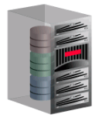
Oracle Secure Backup (OSB) Enterprise Tape Backup Management
Protects Entire IT Environment
Oracle Database 11g Release 2 to Oracle9i
  25 – 40% faster tape backup
Heterogeneous file systems (UNIX/ Linux / Windows) and NAS devices
Built-in Oracle Integration
Centralized management in distributed environments
Over 75% less expensive than comparable products
Oracle Enterprise Manager
Oracle Secure Backup
File System Data
Oracle Database
RMAN Integration
Tape Library
Virtual Tape Library (VTL)
Notes:
Oracle Secure Backup is centralized tape backup management software protecting the Oracle database and file systems in distributed UNIX, Linux, Windows and Network Attached Storage (NAS) environments.
From one central console, you can easy manage the distributed servers and tape devices within the backup domain.
As Oracle is no longer just a database company, Oracle Secure Backup provides tape backup for application files as well as the database. Integrated with Recovery Manager (RMAN), Oracle Secure Backup provides the media management layer for RMAN backups to tape. Complete data protection for your entire environment, OSB provides an alternative to expensive media management products increasing ROI for your customers Oracle investment. Using OSB, tape backup management is automated through user-defined policies through the life cycle of the backup tape from first write to tape duplication (if any) to rotation between multiple locations (vaulting) and finally re-use when upon expiration of the tape.
File system and database backup may be encrypted per user-defined policy or on a one-off basis using OSB native encryption capability or LTO-4 tape drive encryption….OSB seamlessly manages encryption keys for both native encryption or hardware (LTO-4 drives).
OSB is integrated with Enterprise Manager 10gR2…With EM Grid 10.2.0.5, both OSB file system backup operations, database backup operations and media management can be managed through Grid. In addition to EM, OSB backup management may be managed using a command line interface or native web tool.
Oracle database backups provide the fastest database backup to tape (about 25 – 40 % faster) due to optimizations, particularly:
Unused block compression: Only used data blocks are backed up (Oracle Database 10g R2)
Backup undo optimization: Only "active" undo data is backed up (Oracle Database 11g R1)
NOTE: OSB supports 6 platforms and 3 NAS devices.

Slide 17

Oracle Secure Backup Cloud Module
Offsite Database Backups in the Cloud
Database Files /
Fast Recovery Area
RMAN
Oracle Secure Backup Cloud Module
Amazon S3
Compression /
Encryption
Oracle Secure Backup Cloud module: Backup databases to Amazon Cloud
  Complements local disk and/or tape backup
  Eliminates IT management overhead of a disaster recovery site
  Backed by Amazon S3
$3,500 per RMAN channel
More information: http://www.oracle.com/technology/tech/cloud/index.html
Notes:
Works with Oracle9i R2 and higher DB versions
http://aws.amazon.com/s3-sla/

Slide 18
Agenda
<Insert Picture Here>
What Keeps You Awake at Night?
Oracle Data Protection Planning & Solutions
Oracle Backup & Recovery Solutions
  Physical Data Protection
    Recovery Manager
    Oracle Secure Backup
  Logical Data Protection
    Flashback Technologies
  Recovery Analysis
    Data Recovery Advisor
Demo
Q&A

Slide 19
Logical Data Protection
Fast ‘Rewind’ of Logical Errors
Physical Data Protection
Recovery Analysis
Data Recovery Advisor
File System Data
Oracle Databases
UNIX
Linux
Windows
NAS
Logical Data
Protection
Flashback Technologies
Recovery Manager (RMAN)

Slide 20
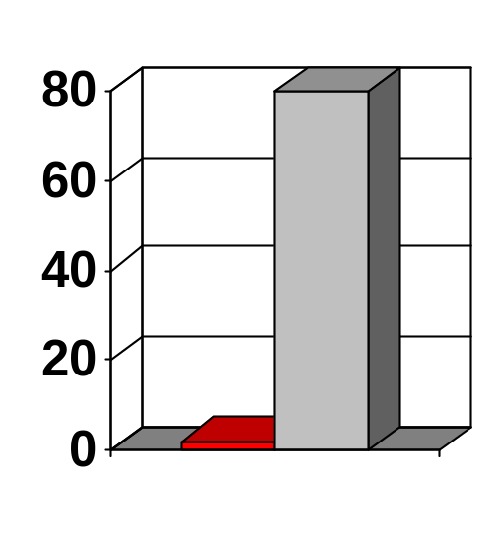
Flashback Technologies
Error Detection & Correction
Traditional Recovery
Recovery Time
Flashback revolutionizes error recovery
  View ‘good’ data as of a past point-in-time
  Simply rewind data changes
  Time to correct error equals time to make error
Flashback
Correction Time = Error Time + f(DB_SIZE)
Low impact
Excellent tool for configuring QA, Dev and Training databases
Flashback is easy – simple commands, no complex procedure
Notes:
Flashback enables easy navigation through time
See all rows at a given time
See all changes to a row
See all changes made by a transaction
Flashback enables easy correction of errors
Row level
Table level
Database level
Flashback applies to all types of users
End users
Developers
Administrators
Flashback is much faster and easier than traditional recovery
=================
Flashback impact
The environment for the OLTP < 2% overhead (actually < 1% in my tests) was a single instance 11.1.0.6 database running the Swingbench Order Entry workload with on Linux 32-bit, RHEL ( 2.6.9-42.0.3.0.1.ELhugemem) and the I/O subsystem was:
Array Serial # Disks Memory
EMC Clariion CX700 #1249 2 Trays - 15 disks per Tray - 73Gb 4Gb per SP (512Mb Read Cache / 2631Mb Write Cache)
EMC Clariion CX500 #1477 2 Trays - 15 disks per Tray - 73Gb 2Gb per SP (365Mb Read Cache / 1107Mb Write Cache)
where the cx700 was the data ASM disk group and the cx500 was the ASM Fast Recovery area disk group. So the FRA had 28 spindles.
Other qualitative reasons for low FB logging impact:
- Only one before-image is logged per 30 min interval, regardless of number of changes to the block
- No extra block reads are required when writing to flashback logs (note: except for direct insert loads, which is fixed in 11.1 for single instance)
- Only data file block changes are tracked, not all database files (e.g. online redo, controlfile, etc.)
- In general, no process needs to wait for flashback log I/O in a well configured OLTP system.

Slide 21
Error Investigation with Flashback
Flashback Query
  Query all data at point in time
select * from Salary AS OF ‘12:00 P.M.’ where …
Flashback Version Query
  See all versions of a row between times
  See transactions that changed the row
Tx 3
select * from Salary VERSIONS BETWEEN
‘12:00 PM’ and ‘2:00 PM’ where …
Tx 2
Flashback Transaction Query
  See all changes made by a transaction
select * from FLASHBACK_TRANSACTION_QUERY
where xid = HEXTORAW(‘000200030000002D’);
Tx 1
All above are based on available UNDO
Notes:
Oracle9i introduced Flashback Query to provide a simple, powerful and completely non-disruptive mechanism for recovering from human errors. It allows users to view the state of data at a point in time in the past without requiring any structural changes to the database.
Oracle Database 10g extended the Flashback Technology to provide fast and easy recovery at the database, table, row, and transaction level. Flashback Technology revolutionizes recovery by operating just on the changed data. The time it takes to recover the error is now equal to the same amount of time it took to make the mistake.
Flashback Query:
Ensure that the database is using an undo tablespace. The setting the UNDO_MANAGEMENT initialization parameter to AUTO specifies this.
Set the UNDO_RETENTION initialization parameter (secs, default=900) to a value that causes undo to be kept for a length of time that allows success of your longest query back in time or to recovery from human errors.
To guarantee that unexpired undo will not be overwritten, set the RETENTION GUARANTEE clause for the undo tablespace.
Flashback Version Query Pseudocolumn Description:
VERSIONS_STARTSCN, VERSIONS_STARTTIME - Starting System Change Number (SCN) or TIMESTAMP when the row version was created. This identifies the time when the data first took on the values reflected in the row version. You can use this to identify the past target time for a Flashback Table or Flashback Query operation. If this is NULL, then the row version was created before the lower time bound of the query BETWEEN clause.
VERSIONS_ENDSCN, VERSIONS_ENDTIME - SCN or TIMESTAMP when the row version expired. This identifies the row expiration time. If this is NULL, then either the row version was still current at the time of the query or the row corresponds to a DELETE operation.
VERSIONS_XID - Identifier of the transaction that created the row version.
VERSIONS_OPERATION - Operation performed by the transaction: I for insertion, D for deletion, or U for update. The version is that of the row that was inserted, deleted, or updated; that is, the row after an INSERT operation, the row before a DELETE operation, or the row affected by an UPDATE operation. Note: For user updates of an index key, a Flashback Version Query may treat an UPDATE operation as two operations, DELETE plus INSERT, represented as two version rows with a D followed by an I.
The following statement queries the FLASHBACK_TRANSACTION_QUERY view for transaction information, including the transaction ID, the operation, the operation start and end SCNs, the user responsible for the operation, and the SQL code to undo the operation:
SELECT xid, operation, start_scn,commit_scn, logon_user, undo_sql
FROM flashback_transaction_query
WHERE xid = HEXTORAW('000200030000002D');

Slide 22
Error Correction with Flashback
Database
Flashback Database – restore database to any point in time
Flashback Table – restore contents of tables to any point in time (undo-based)
Flashback Drop – restore accidentally dropped tables (based on free space in tablespace)
Flashback Transaction – back out transaction and all subsequent conflicting transactions (redo-based)
Customer
Order
Notes:
Flashback Database – restore database to point-in-time
Imagine a bad batch job that has impacted your entire database, incorrectly modifying data across many tables and even certain PL/SQL procedures. The only corrective action would be to import a previous good data set, provided you have them, or to restore a good backup and roll the database forward to a point-in-time prior to the time of the batch job. Both can potentially entail long recovery times into the hours or days.
Oracle Database 10g features Flashback Database, a unique database point-in-time recovery capability, which allows the database to be ‘rewound’ to a prior point-in-time within seconds or minutes. Because only the affected data blocks are restored and recovered, it’s faster than traditional recovery methods. The command is simply ‘flashback database to my point-in-time’
We accomplish this fast recovery by utilizing flashback logs which record old block versions. When writes are issued to disk and flashback database is enabled, the old block version is written to the flashback log while the new block version is written to datafiles. When a flashback database command is issued, only the changed blocks are retrieved from the flashback logs and then recovered with appropriate archived logs to the required point-in-time. You control how far back to retain flashback logging to support your recovery requirements. For example you might enable flashback database for 24 hrs, and then rely on backups for recovery past 24 hrs.
Flashback Table – recover contents of tables to point-in-time (undo-based)
Flashback Drop – restore accidentally dropped tables (based on free space in tablespace)
Flashback Transaction – back out transaction and all subsequent conflicting transactions (redo-based)

Slide 23



Flashback Database
Continuous Data Protection (CDP)
Fast point-in-time recovery strategy
Eliminate the need to restore a whole database backup
Continuous data protection for database
  Optimized, before-change block logging
  Restores just changed blocks
  Replay log to restore DB to desired time
It’s fast - recover in minutes, not hours
It’s easy - single command restore
  Flashback Database to ‘2:05 PM’
Disk Write
New Block
Version
Old Block
Version
Data Files
Flashback
Log
“Rewind” button for the Database
Notes:
Imagine a bad batch job that has impacted your entire database, incorrectly modifying data across many tables and even certain PL/SQL procedures. The only corrective action would be to import a previous good data set, provided you have them, or to restore a good backup and roll the database forward to a point-in-time prior to the time of the batch job. Both can potentially entail long recovery times into the hours or days.
Oracle Database 10g features Flashback Database, a unique database point-in-time recovery capability, which allows the database to be ‘rewound’ to a prior point-in-time within seconds or minutes. Because only the affected data blocks are restored and recovered, it’s faster than traditional recovery methods. The command is simply ‘flashback database to my point-in-time’
We accomplish this fast recovery by utilizing flashback logs which record old block versions. As you can see in the diagram, when writes are issued to disk and flashback database is enabled, the old block version is written to the flashback log while the new block version is written to datafiles. When a flashback database command is issued, only the changed blocks are retrieved from the flashback logs and then recovered with appropriate archived logs to the required point-in-time. You control how far back to retain flashback logging to support your recovery requirements. For example you might enable flashback database for 24 hrs, and then rely on backups for recovery past 24 hrs.
Flashback also critical for fast reinstatement of new standby after failover & snapshot standby.

Slide 24
Agenda
<Insert Picture Here>
What Keeps You Awake at Night?
Oracle Data Protection Planning & Solutions
Oracle Backup & Recovery Solutions
  Physical Data Protection
    Recovery Manager
    Oracle Secure Backup
  Logical Data Protection
    Flashback Technologies
  Recovery Analysis
    Data Recovery Advisor
Demo
Q&A

Slide 25
Recovery Analysis
Intelligent, Guided Recovery
Physical Data Protection
Recovery Analysis
Data Recovery Advisor
File System Data
Oracle Databases
UNIX
Linux
Windows
NAS
Logical Data
Protection
Flashback Technologies
Recovery Manager (RMAN)

Slide 26

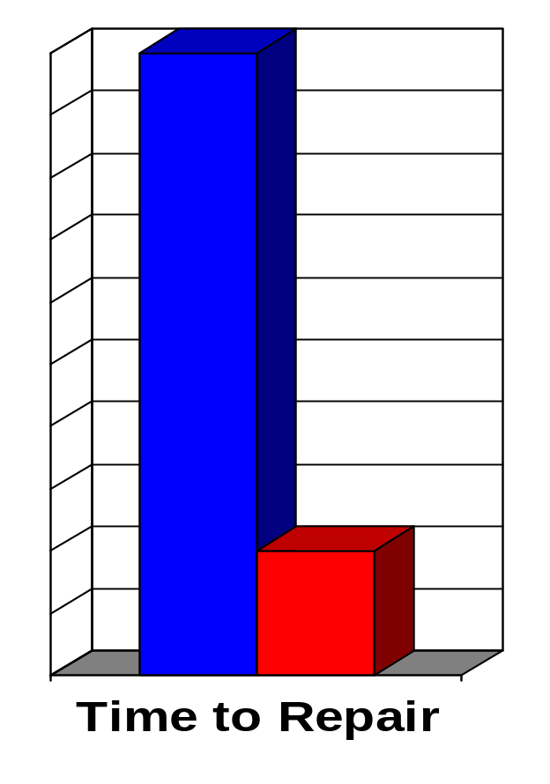
Data Recovery Advisor
The Motivation
Investigation & Planning
Oracle provides robust tools for data repair:
  RMAN – physical media loss or corruptions
  Flashback – logical errors
  Data Guard – physical problems
However, problem diagnosis and choosing the right solution can be error prone and time consuming
  Errors more likely during emergencies
Recovery
Notes:
Data Guard –
There are two options using a standby database that can be used to repair block corruption on the primary database:
• Extract the rows from the block that is corrupted on the primary by using Data Pump or other means to select the data from a table. The data is then re-inserted into the primary database.
• Copy the standby database datafile(s) to the primary database. Once the file is restored on the primary database, archived logs are applied to bring it consistent with the rest of the database.
If the primary database corruption is widespread due to a bad controller or other hardware/software problem, then you may want to switchover to the standby database while repairs to the primary database server are made.

Slide 27
Data Recovery Advisor (DRA)
Oracle Database tool that automatically diagnoses data failures, presents repair options, and executes repairs at the user's request
Determines failures based on symptoms
  E.g. an “open failed” because datafiles f045.dbf and f003.dbf are missing
  Failure Information recorded in diagnostic Automatic Diagnostic Repository (ADR)
  Flags problems before user discovers them, via automated health monitoring
Intelligently determines recovery strategies
  Aggregates failures for efficient recovery
  Presents only feasible recovery options
  Indicates any data loss for each option
Can automatically perform selected recovery steps
Accessed via RMAN or EM
Reduces downtime by eliminating confusion
Notes:
Data Recovery Advisor can diagnose failures such as the following:
Components that are not accessible because they do not exist, do not have the correct access permissions, are taken offline, and so on
Physical corruptions such as block checksum failures, invalid block header field values, and so on
Logical corruptions caused by software bugs
Incompatibility failures caused by an incorrect version of a component
I/O failures such as a limit on the number of open files exceeded, channels inaccessible, network or I/O error, and so on
Configuration errors such as an incorrect initialization parameter value that prevents the opening of the database
Intelligently determines recovery strategies
Aggregates failures for efficient recovery – propose single script with appropriate commands in order, to cover all failures if possible vs. multiple scripts
Presents only feasible recovery options, e.g. propose RMAN restore script only if needed backups are available. Can also check for available Flashback logs and standby database (in 10.2.0.5 Grid Control) for recovery options.
Indicates any data loss for each option, e.g. if point-in-time recovery is only option (due to missing backups or logical error)

Slide 28
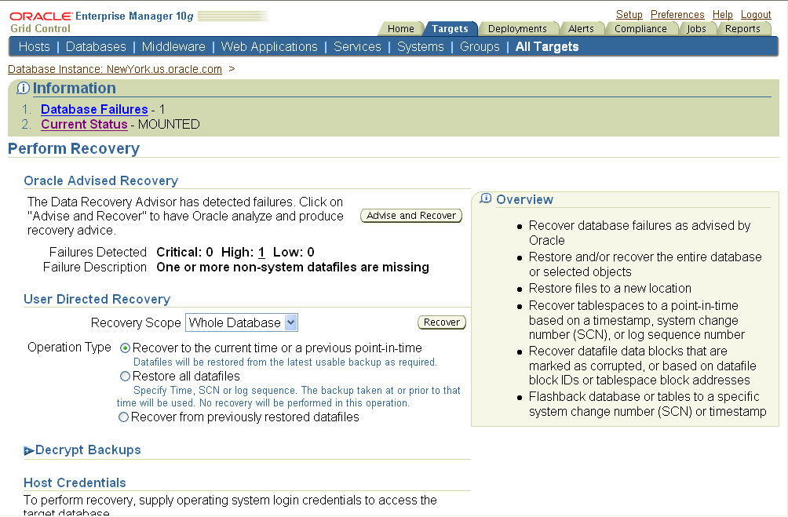
Data Recovery Advisor Wizard

Slide 29
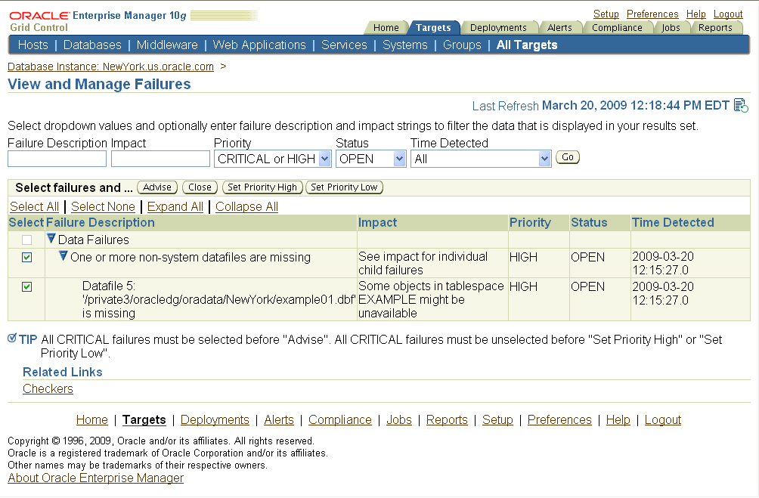
Data Recovery Advisor – View Failures

Slide 30
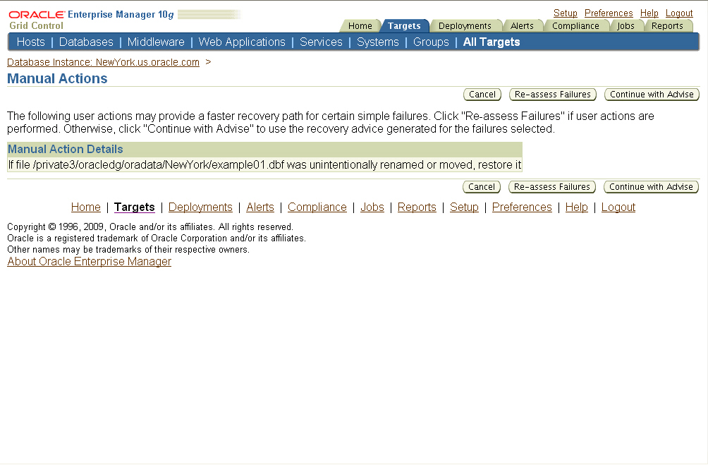
Data Recovery Advisor – Manual Repair

Slide 31
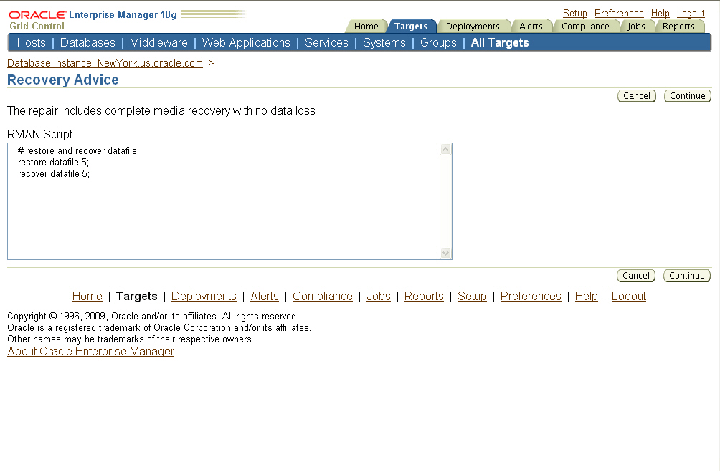
Data Recovery Advisor – Recovery Advice

Slide 32
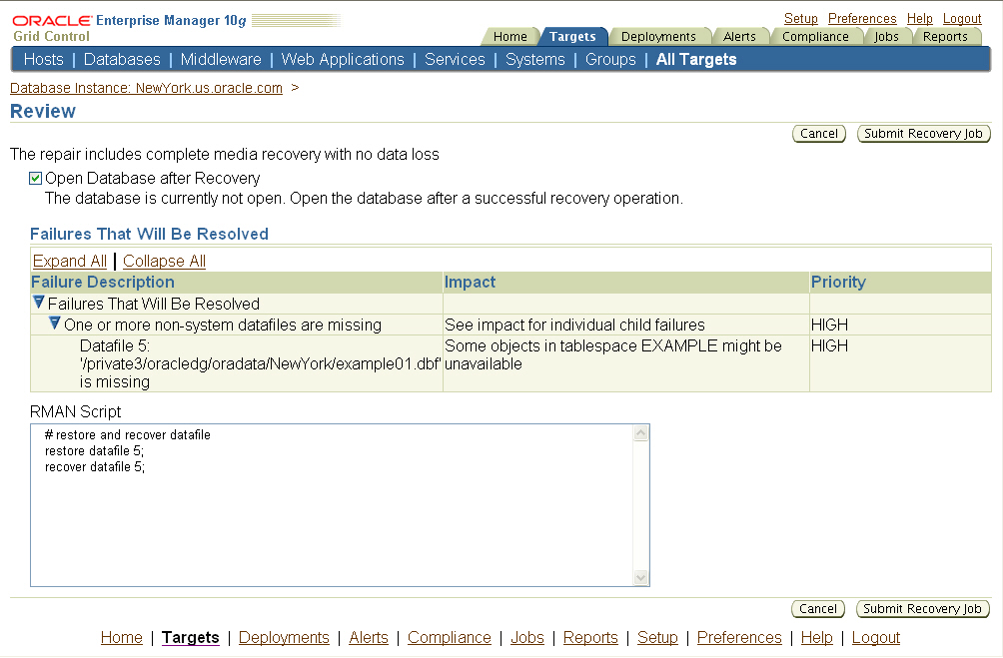
Data Recovery Advisor – Summary

Slide 33
Agenda
<Insert Picture Here>
What Keeps You Awake at Night?
Oracle Data Protection Planning & Solutions
Oracle Backup & Recovery Solutions
  Physical Data Protection
    Recovery Manager
    Oracle Secure Backup
  Logical Data Protection
    Flashback Technologies
  Recovery Analysis
    Data Recovery Advisor
Conclusion and other technologies

Slide 34
Oracle Backup & Recovery Solutions
Complete & Targeted Recovery
Recovery Analysis
Logical Data Protection
Physical Data
Protection
Recovery Manager
Oracle Secure Backup
Flashback Technologies
Data Recovery Advisor
Notes:
Leverage Integrated Oracle Backup & Recovery Solutions
Physical Data Protection
Recovery Manager
Comprehensive physical backup and recovery
Oracle Secure Backup
Centralized tape backup for database and file system data
Fastest Oracle database backup to tape
Low-cost, per-tape drive licensing
Innovative database backup to Cloud storage
Logical Data Protection
Flashback Technologies
Fast, point-in-time database ‘rewind’
Fine-grained recovery at row, transaction, and table
Recovery Analysis
Intelligent, guided recovery with Data Recovery Advisor

Slide 35
Oracle Real Application Clusters (RAC)
Oracle RAC enables a single database to run across a cluster of servers, providing unbeatable fault tolerance, performance, and scalability with no application changes necessary.
BENEFITS
24/7 availability—Provide continuous uptime for database applications
On-demand scalability—Expand capacity by simply adding servers to your cluster
Lower computing costs—Use low-cost commodity hardware and reduce cost of downtime
World-record performance—Runs faster than the fastest mainframe
Grid computing—Oracle RAC is the foundation for grid computing
Notes:
Oracle RAC is a cluster database with a shared cache architecture that overcomes the limitations of traditional shared-nothing and shared-disk approaches to provide highly scalable and available database solutions for all your business applications. Oracle RAC is a key component of Oracle enterprise grid architecture.
Oracle Database Standard Edition includes Real Application Clusters support for higher levels of system uptime. Oracle RAC One Node is a new option with Oracle Database 11g Release 2 is a single instance of Oracle RAC running on one node in a cluster. This option adds to the flexibility that Oracle offers for database consolidation while reducing management overhead by providing a standard deployment for Oracle Databases in the enterprise.

Slide 36
Data Guard
Production database (primary database) + one or more standby database(s),
Standby databases are transactionally consistent copies of the production database.
As transactions occur in the primary database, redo data is generated and is written to the local redo logs.
Data Guard automatically transfers this redo data to the standby sites and applies it to the standby databases, synchronizing them with the primary database
Notes:
Data Guard enables and automates the management of a disaster recovery solution for Oracle databases located on the same campus or across the continent. Data Guard consists of a production database (also known as the primary database) and one or more standby database(s), which are transactionally consistent copies of the production database. As transactions occur in the primary database, redo data is generated and is written to the local redo logs. Data Guard automatically transfers this redo data to the standby sites and applies it to the standby databases, synchronizing them with the primary database.

Slide 37
Oracle Data Guard and Real Application Clusters
Complementary to each other
RAC: rapid and automatic recovery from failures, increase scalability
Data Guard: provides data protection through the use of transactionally consistent primary and standby databases
Notes:
Oracle Data Guard and Real Application Clusters (RAC) are complementary to each other. RAC addresses system failures. It provides rapid and automatic recovery from failures that do not affect data - such as node failures, or instance crashes. It also provides increased scalability for an application. Data Guard, on the other hand, provides data protection through the use of transactionally consistent primary and standby databases, which neither share disks nor run in lock step. This enables recovery from site disasters or data corruptions.
Customers should use a combination of Oracle Data Guard and Real Application Clusters to get the benefits of both data-level and system-level protection, resulting in an end-to-end High Availability solution.

Slide 38
Automatic Storage Management (ASM)
ASM provides DBA with a simple storage management interface that is consistent across all server and storage platforms.
ASM saves the DBAs time and provides flexibility to manage a dynamic database environment
Notes:
Automatic Storage Management (ASM)provides database administrator with a simple storage management interface that is consistent across all server and storage platforms. As a vertically integrated file system and volume manager, purpose-built for Oracle database files, ASM provides the performance of async I/O with the easy management of a file system. ASM provides capability that saves the DBAs time and provides flexibility to manage a dynamic database environment with increased efficiency.
Automatic Storage Management (ASM) feature in Oracle Database 11g Release 2 extends ASM functionality to manage ALL data: Oracle database files, Oracle Clusterware files and non-structured general-purpose data such as binaries, externals files and text files. ASM simplifies, automates and reduces cost and overhead by providing a unified and integrated solution stack for all your file management needs eliminating the need for 3rd party volume managers, file systems and clusterware platforms.

Slide 39


